Slide 1
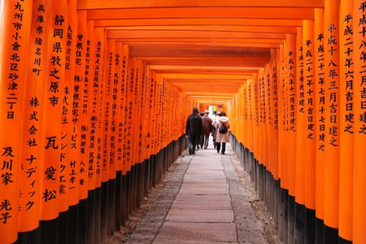
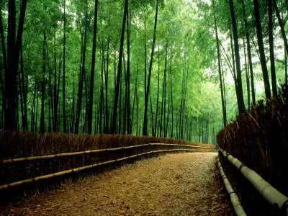
Proposal to host
SOCG 2014 in KYOTO, JAPAN
The 30th ACM Symposium on Computational Geometry

Slide 2
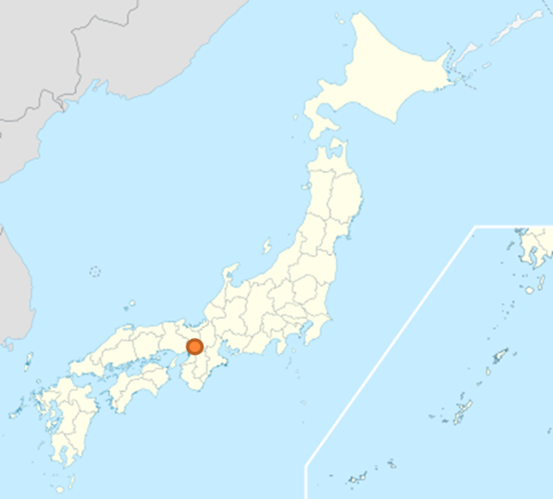
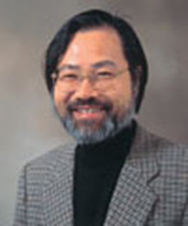
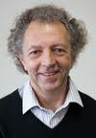
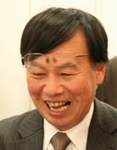
Plan
Place: Kyoto, Japan
Date : June 9(Mon)-11(Wed)
  Tentative
Venue: Kyoto University Centennial Memorial Hall
Local organizers:
  Tetsuo Asano (JAIST)
  David Avis (Kyoto, McGill)
  Naoki Katoh (Kyoto)
  Takeshi Tokuyama (Tohoku)
Kyoto

Slide 3
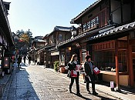
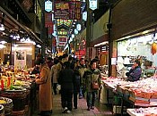
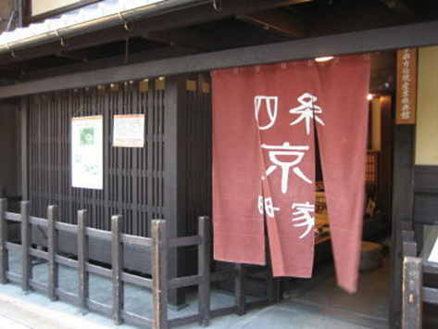
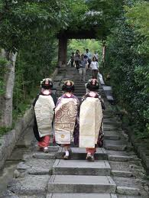
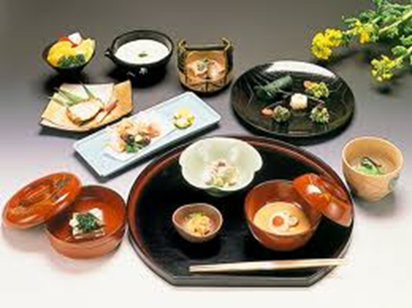
KYOTO CITY
The old capital (794-1603) of Japan
A very attractive city to visit
  City with old Japanese atmosphere
  17 UNESCO world heritage sites
  Good foods, excellent transportation
  Comfortable to stay (I was born there)

Slide 4
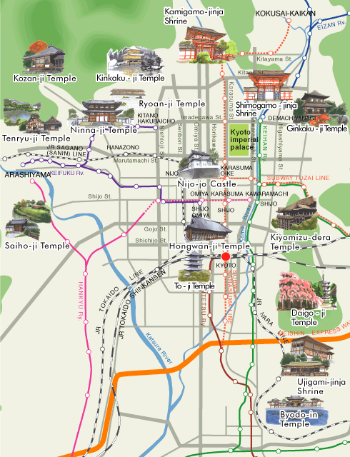
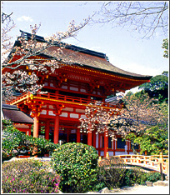
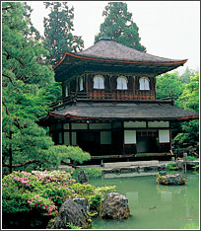
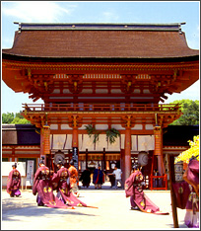
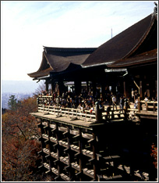
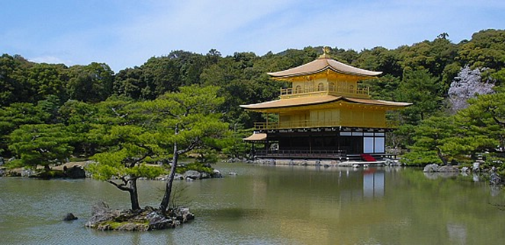
SOCG Venue
17 UNESCO world heritage sites in Kyoto

Slide 5
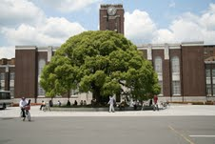
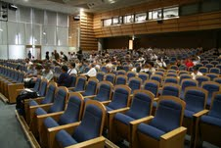
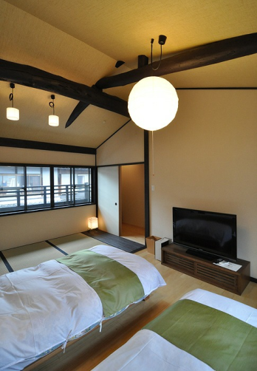
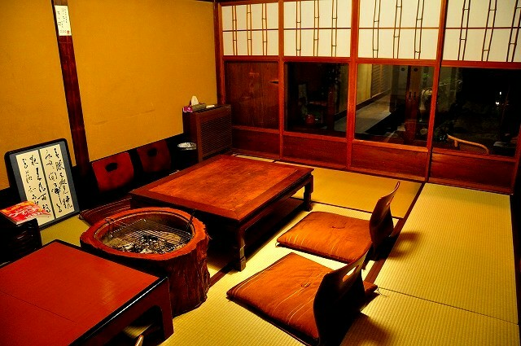
Venue & accommodation
Kyoto University
  2nd oldest university in Japan
Centennial memorial hall
  At the main gate of the main campus
Accommodation
  Many hotels in Kyoto city
    5,000 –10,000 yen
    10-20 min by public transportation
  Japanese style “Ryokan”
  Kyoto style classic house “Machiya”
    Good for group stay

Slide 6


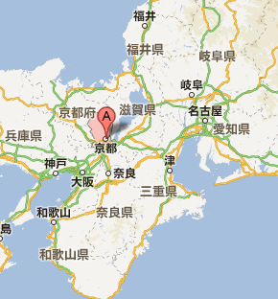

Travel
  Kansai airport is the international airport near Kyoto
    Many flights from Europe, Asia, North America
    Airfare: $700 from San Francisco (Delta) and Frankfurt (KAL)
    70 min by train or 80 min by airport limousine bus (comfortable)
  Osaka airport (domestic) via connection at Narita airport
  From Tokyo, bullet train takes 2 hours 20 min.
Finance
  We will find outside funding
    Keep registration fee reasonable
    Partially support travel of students
Satellite event
  A workshop in Kanazawa
    Organized by Tetsuo Asano
  We welcome event proposals

Slide 7
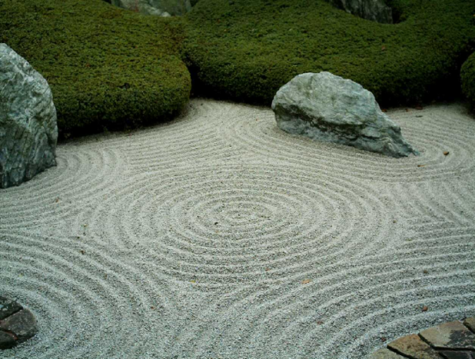
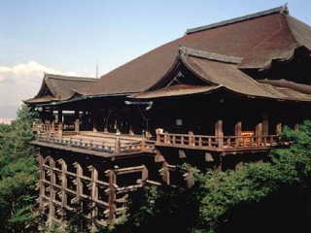
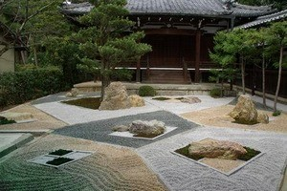
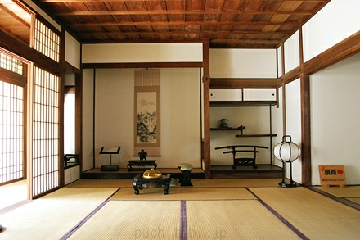
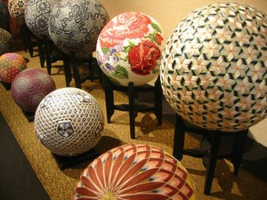
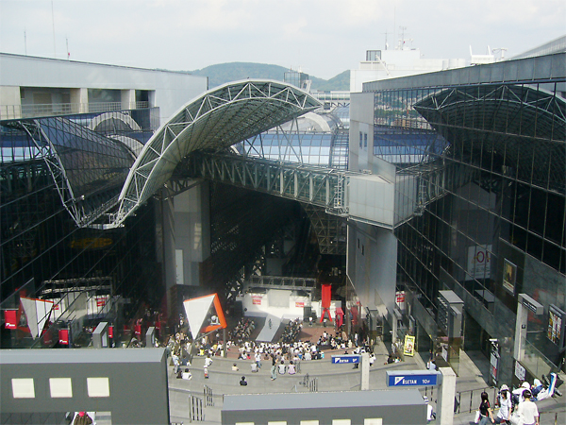
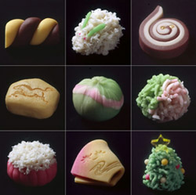
Geometry in KYOTO
Hoping to see you at SOCG
in Kyoto
Kyoto Sweets

